Slide 1
Access Queries

Slide 2
Access query
A query is a question you ask about the data stored in a database table.
Access responds by displaying the data according to your question.
For example
  if you want to see all the customers from New York …
  … you formulate a query to display only the records whose state field matches with NY
Access provides GUI to create queries
Queries are implemented as SQL statements

Slide 3
Using the Query Design view
You specify which fields you want to be included in your query results with the design grid
  Each column in the design grid represents a field that will be used in the query.
  Add fields to the design grid by double-clicking the field in the field list or by dragging the field to the design grid.
  If you move a field to the design grid and then you want to remove it, you can click on the field's column and then press the delete key.
You control what records are displayed in the query by specifying select query criteria
  Use the criteria row(s) to specify the values to be displayed

Slide 4
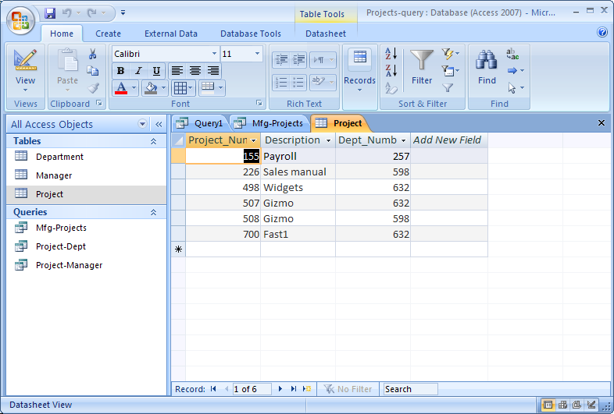
Example: Project table in datasheet view

Slide 5
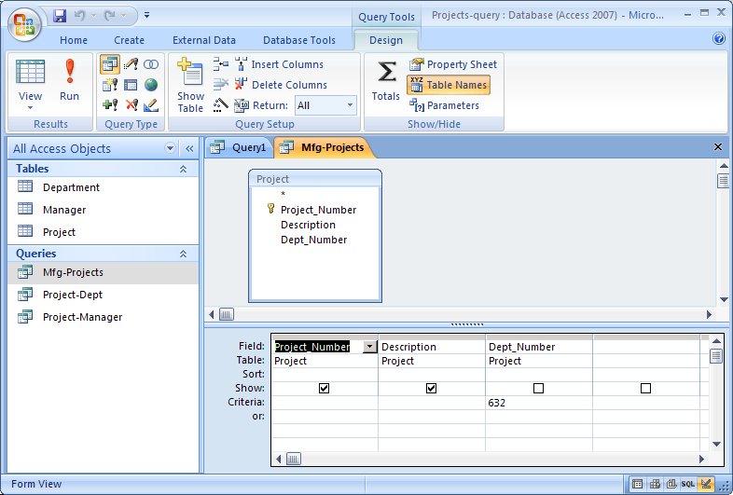
Query 1 in Design view ( “Dept 632 projects ?)
design grid

Slide 6
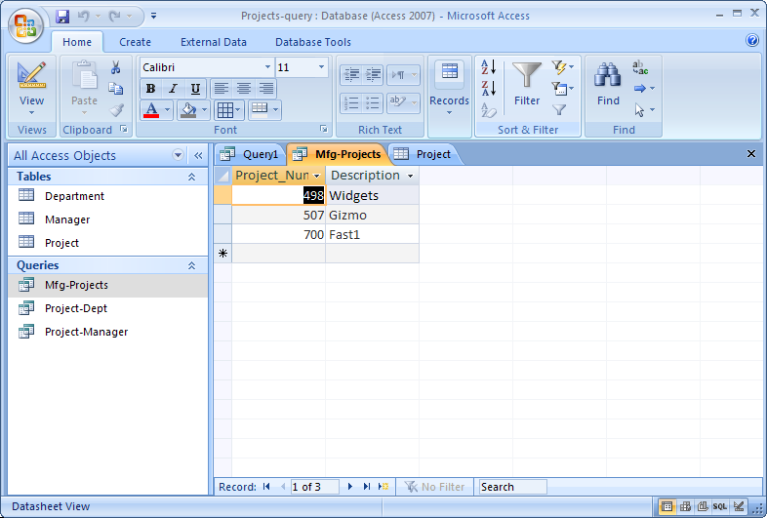
Results of running Query 1 (“dept 632 projects?”)

Slide 7
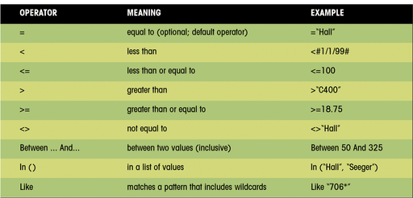
Match operators and results

Slide 8
Use the And and Or logical operators
When you need to use multiple conditions for a query, you can use the logical operators to combine conditions.
  The And logical operator specifies that both conditions must be met
  The Or logical operator specifies that one or the other of the conditions must be met
When you enter two conditions on the same row of the query design grid, an And condition is created.
If you enter two conditions that are on separate rows,
an Or condition is created.

Slide 9
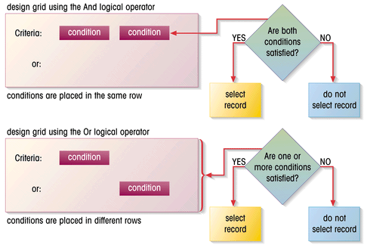
Illustration of And and Or logic
The And condition.
The Or condition.

Slide 10
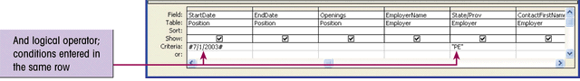
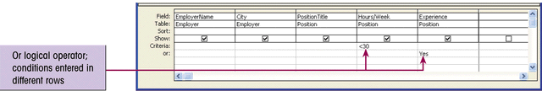
Creating And and Or conditions in the design grid
And conditions must be specified on the same line.
Or conditions must be specified on different lines.

Slide 11
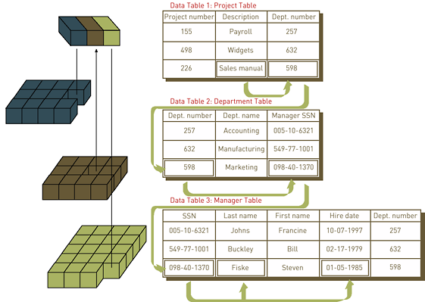
Database Relationships in Keys

Slide 12
Relationships Between Tables
Access allows you to form relationships between tables that make explicit underlying associations in the data.
When you form a relationship between tables, you are joining the tables.
  Tables are joined on common fields between the tables.
  When tables are joined, you can view data from both tables as if the tables were one combined table.
Queries can be defined to use the relationship to extract data from both tables in a single query.

Slide 13
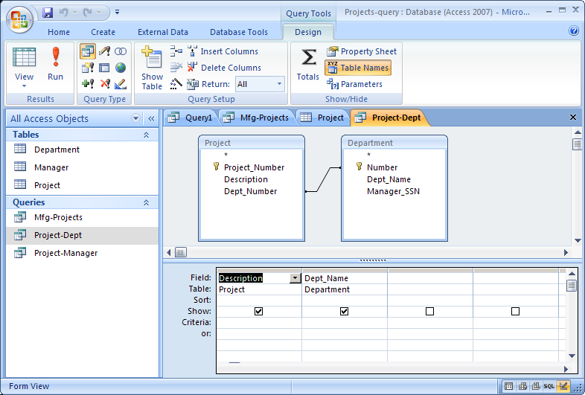
Query - “What is dept name for each project?”

Slide 14
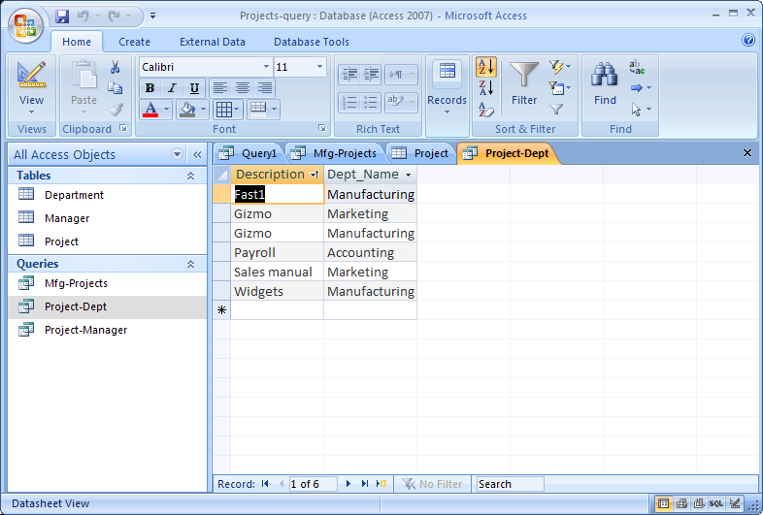
Query - Results

Slide 15
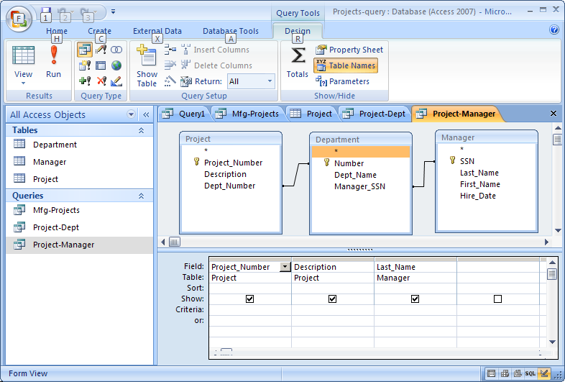
Query - “Who is the manager for each project?”

Slide 16
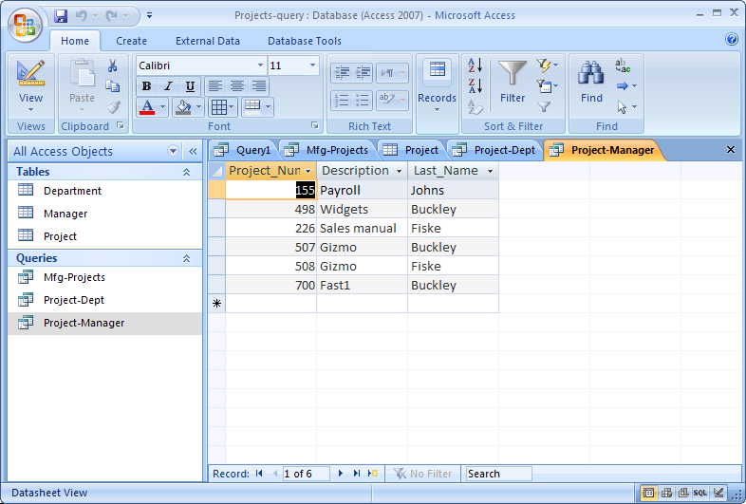
Query - Results

Slide 17
END

